Slide 1
FINAL PROJECT – BAN6420 NAME: CHIEBUKA VICTORIA CHIBUIKE DATE: 29TH AUGUST 2024 LEARNER ID: cchibuike@learner.nexford.org

Slide 2
CONTENTS:
Introduction.
Visualizing Age-Income Distribution Using Matplotlib and Seaborn.
Visualizing Gender Distribution Across Spending Categories.
References.

Slide 3

INTRODUCTION
This presentation illustrates how age impacts the earning capabilities of an individual. It also contains a visualization that show expense categories among females and males. It clearly explains the expense category that require major spending and the minor expense categories.

Slide 4
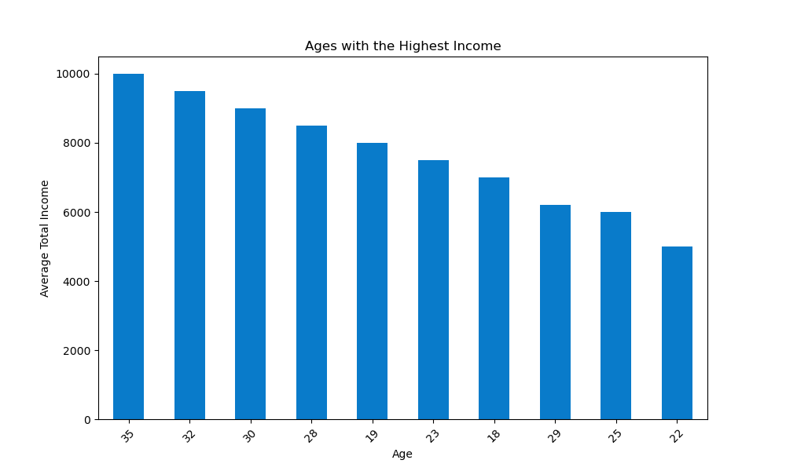
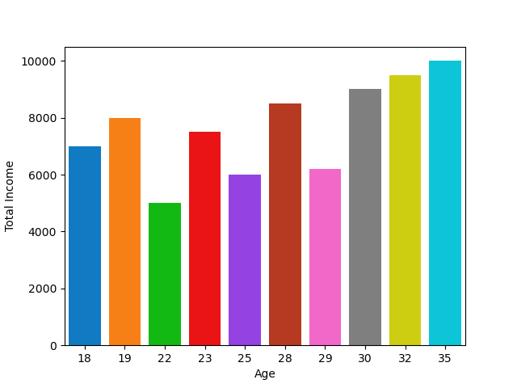
Visualizing Age-Income Distribution Using Matplotlib and Seaborn. “Matplotlib is a visualization tool in python used to create interactive visualizations. Seaborn is a statistical visualization library built on top of matplotlib” (Programming In Python And R, 2024, Module 4, Section 3). In this scenario, these tools were used to create visualizations illustrating how age impacts income. From the charts below, the older one gets, the higher his income. This could be due to factors such as career advancements and developments, exposure, and years of experience.

Slide 5
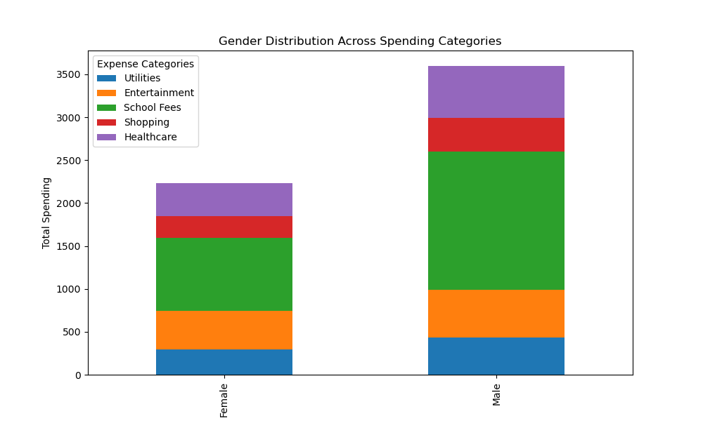
Visualizing Gender Distribution Across Spending Categories.
The chart below explains the spending categories across both gender. From the Chart, a greater proportion of resources across both genders are expended on “School Fees”. This is closely followed by “Healthcare”, “Entertainment”, “Utilities” and lastly “Shopping”.

Slide 6
REFERENCES
Programming In R And Python. Module 4: Data Visualization In R And Python For Data Analysis. August 2024. https://nexford.instructure.com/courses/5256/pages/the-importance-of-data-visualization?module_item_id=230683
Programming In R And Python. Module 6: Use of R And Python In Emerging Technologies. August 2024. https://nexford.instructure.com/courses/5256/pages/emerging-technologies-in-python-and-r?module_item_id=230726

